Slide 1
CropAI
One-stop solution to suicide by farmers

Slide 2
Reasons for suicide:
Bad crop:
Adverse Climatic Conditions
Unpredictable Weather Conditions
Poor Farming Practices
Pests and Diseases
Solution:
Best crop prediction and comparison with current crop based on location.
Methodology:
Rainfall prediction - Time series analysis using Holt Winter Prediction algorithm
Temperature prediction -Time Series Analysis using Holt Winter Prediction algorithm
Soil moisture content (based on dataset) - Previous crop grown in soil
Market trend - Based on crop demands by buyers.

Slide 3
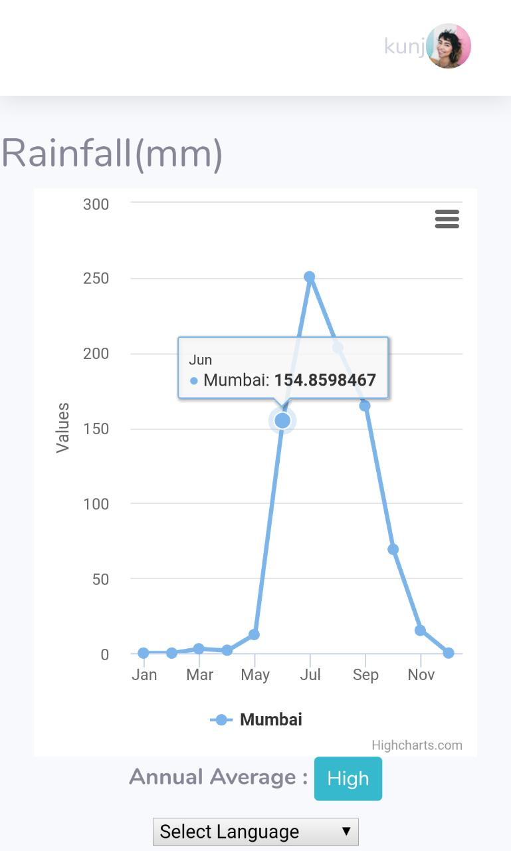
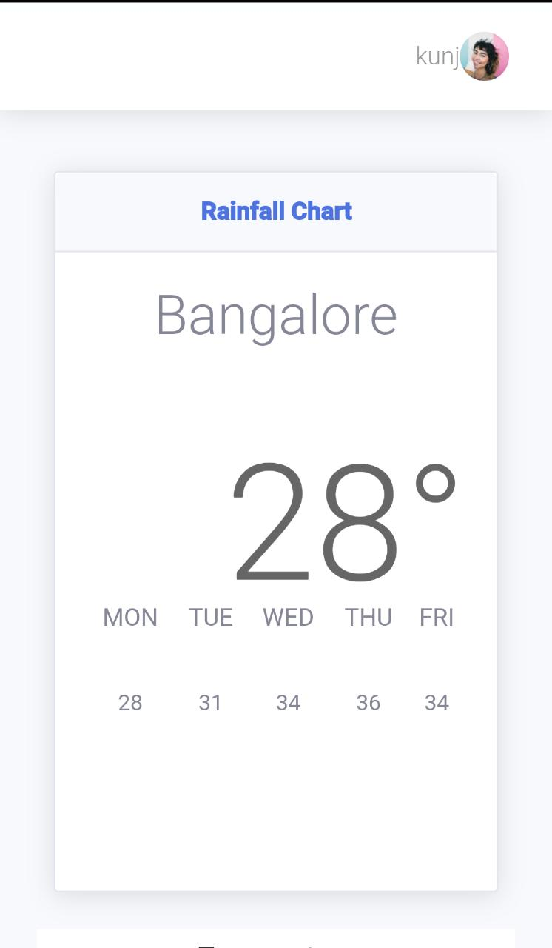
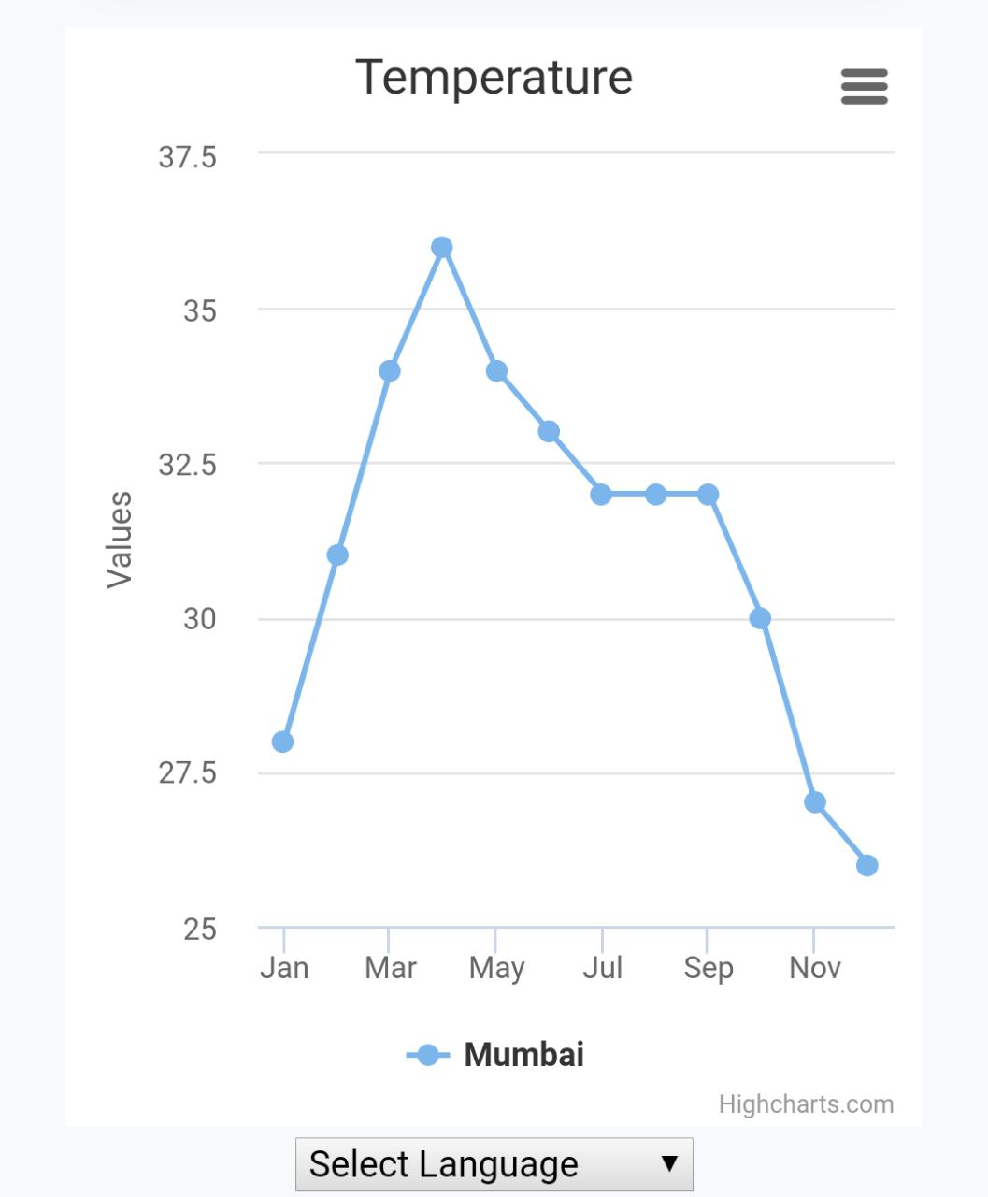

Slide 4
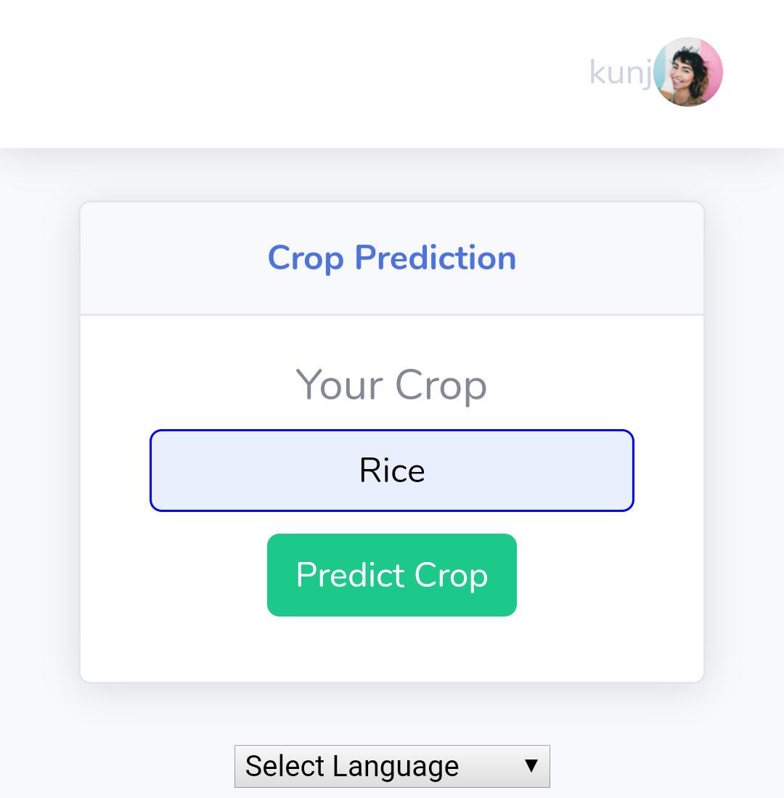
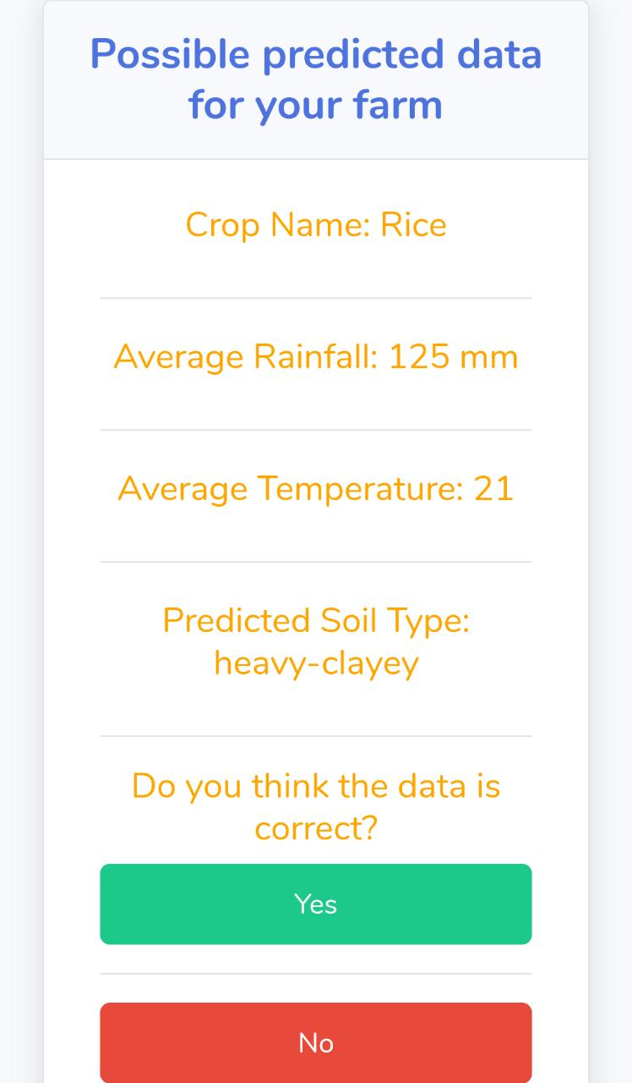
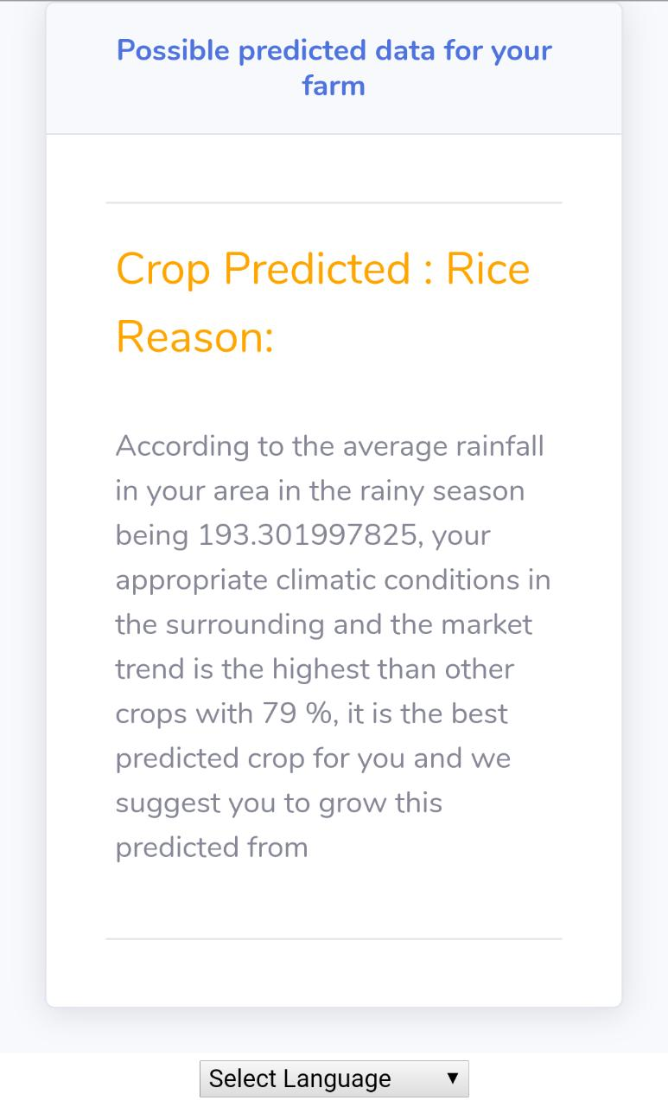
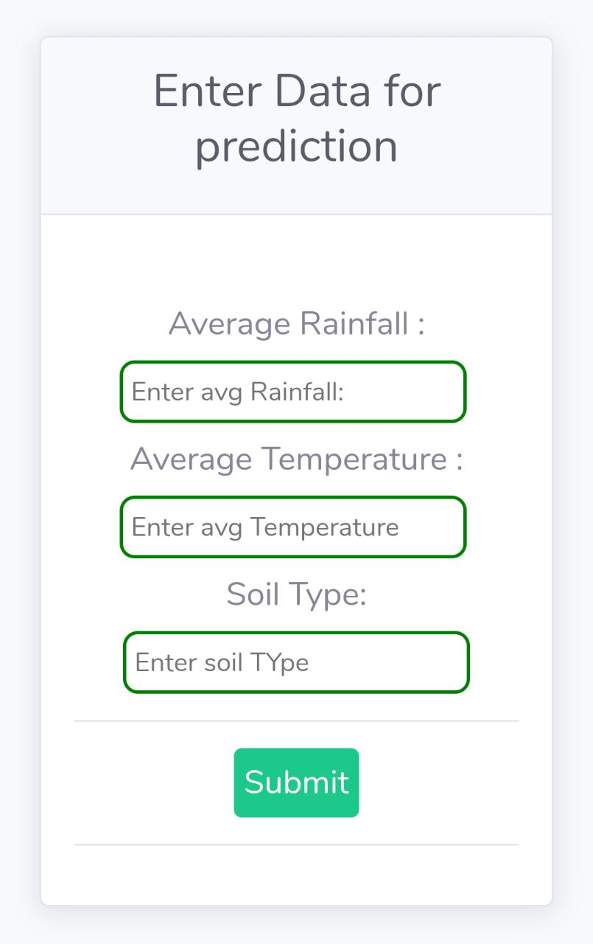

Slide 5
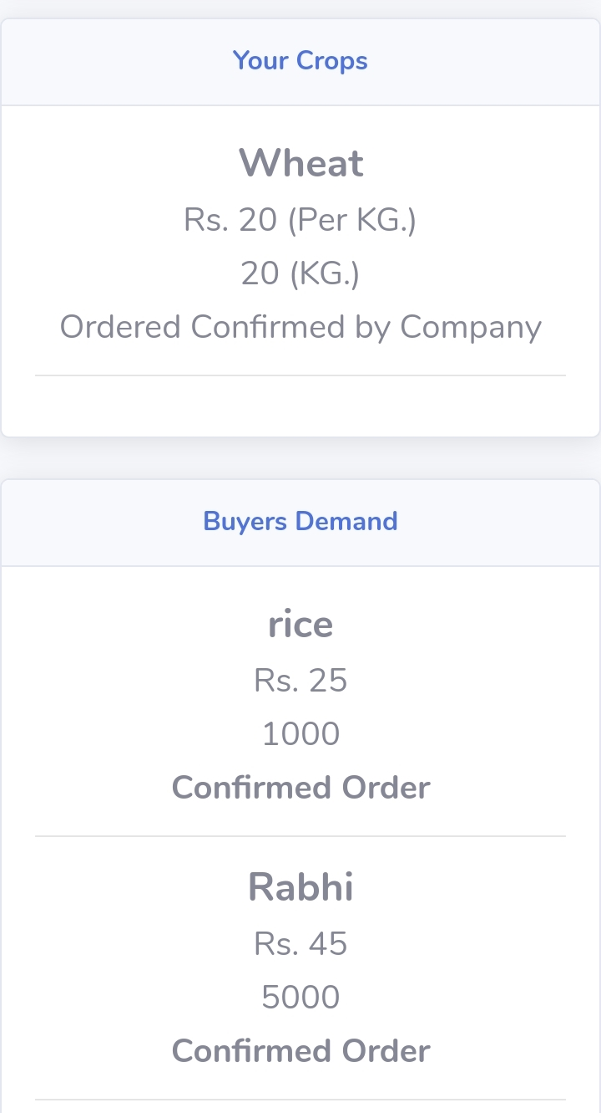
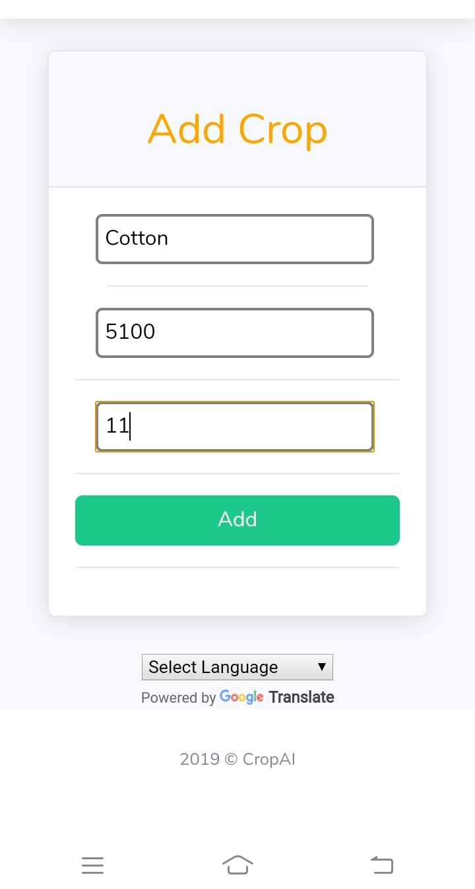
2. Bad rates : Farmers do not get the correct worth of their products.
Middle men
Solution : CropAI-Buyer
Connect the Buyer companies directly to the farmer.

Slide 6

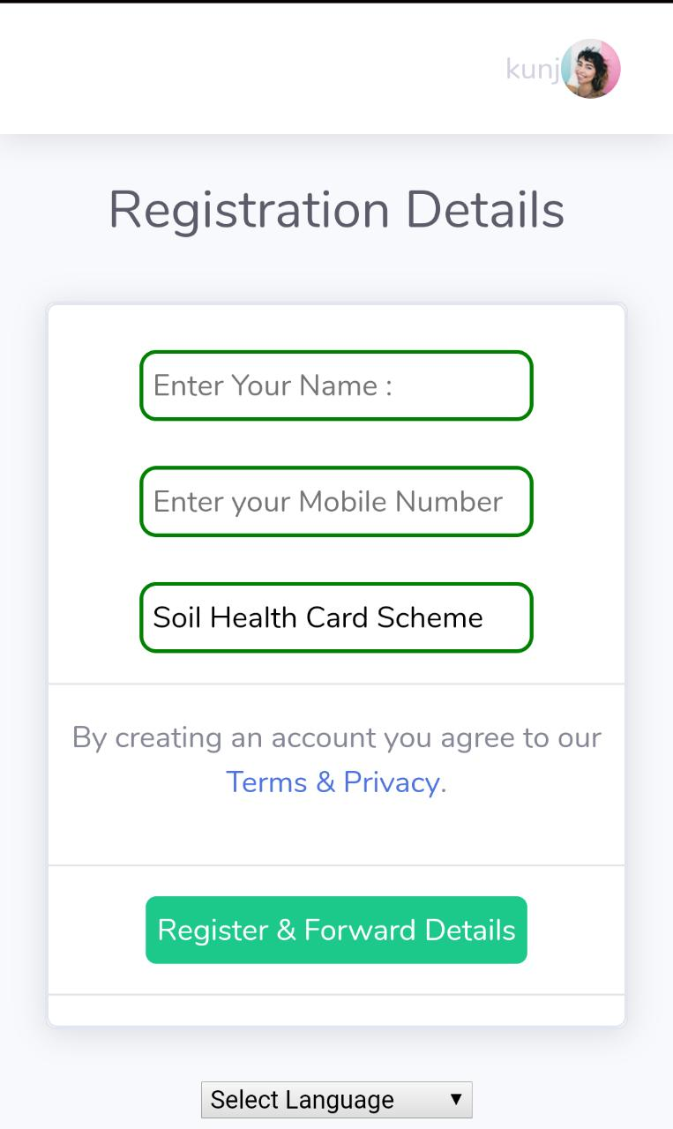
3. Loan Sharks : Private money lending is illegal, the accused have been charged with multiple offences.
Reason : “Lack of awareness of various loan policies and government schemes”
Solution:
One place for all the Government Schemes for farmers
Agricultural loan details
Details of banks providing loans as well as nearest bank based on location.

Slide 7
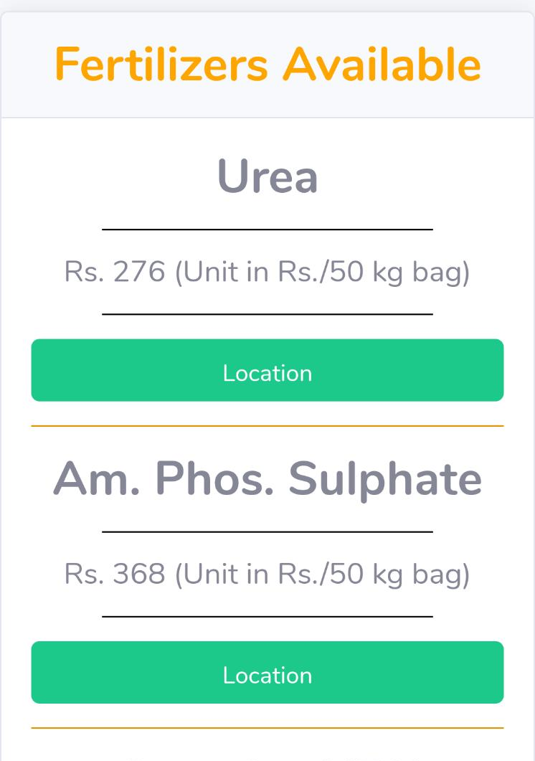
Fertilizer Availability : CropAI- Fertilizer
An app for stores selling fertilizers
Shop will register with the app and will be verified by GST Registration no. , Pan Card no. etc.
Fertilizers available for sale will be added along with price and quantity
Seller won’t be allowed to enter a price higher than current maximum selling price
Farmer will be shown with the nearest shop based on his location and available fertilizer.

Slide 8
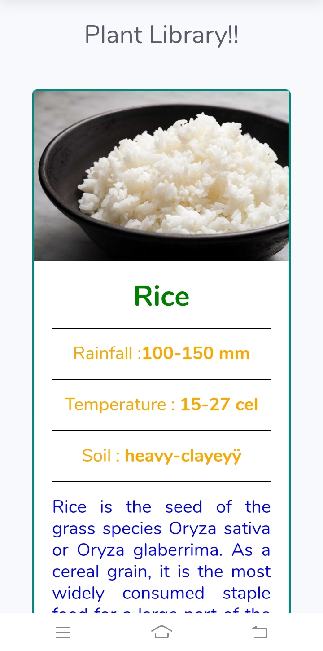
Plant Library
Aim : To show crop information
Solution : One page with detailed information about growing crops.

Slide 9
Expert Chat and YouTube Help Recommendations
Aim : Improve farmer network connectivity to provide easy solutions to queries.
Solution: Group chat for farmers on the network , along with added industry experts advice and youtube recommendations for queries.
Method:
Django Channels - Group chat
YouTube API for search queries

Slide 10
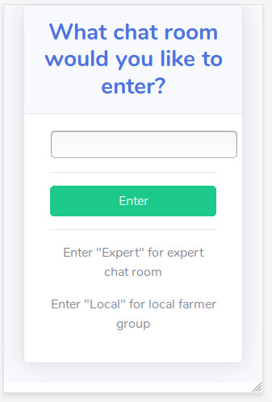
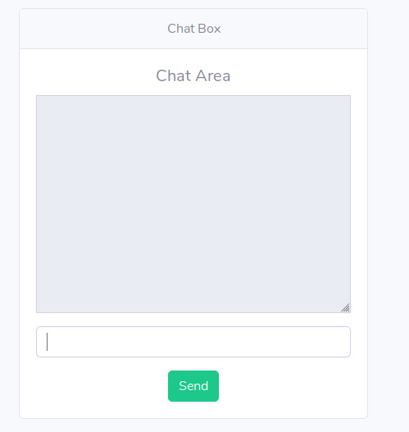


Slide 11
Finance Handing
Aim : Budget Management
Solution :
Budget Manager that takes farmers income and expenses as input prepares a budget so that expenditure does not exceed income and farmer is saved from debts.
EMI calculations based on loans taken will also be done and deducted from the income.
Method :
Python for backend
Estimation of monthly expense and income based on previous inputs incase farmer doesn’t enter few values.

Slide 12
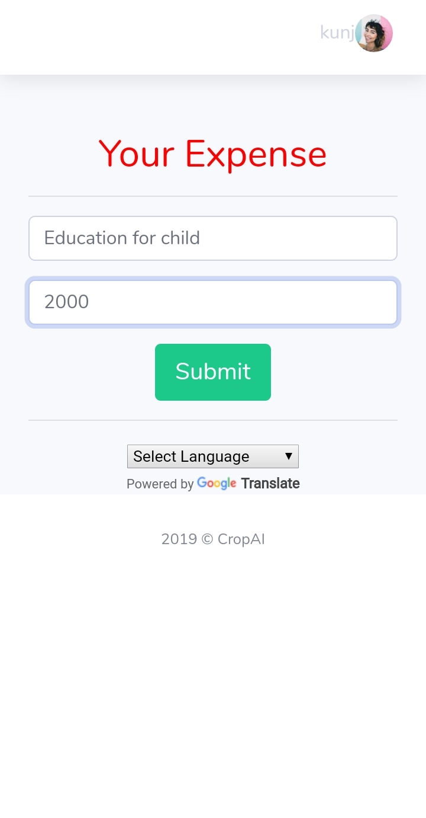
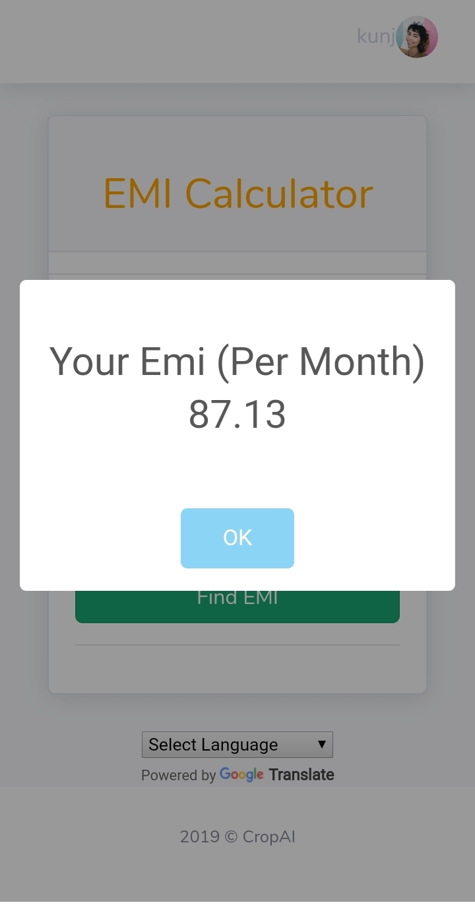
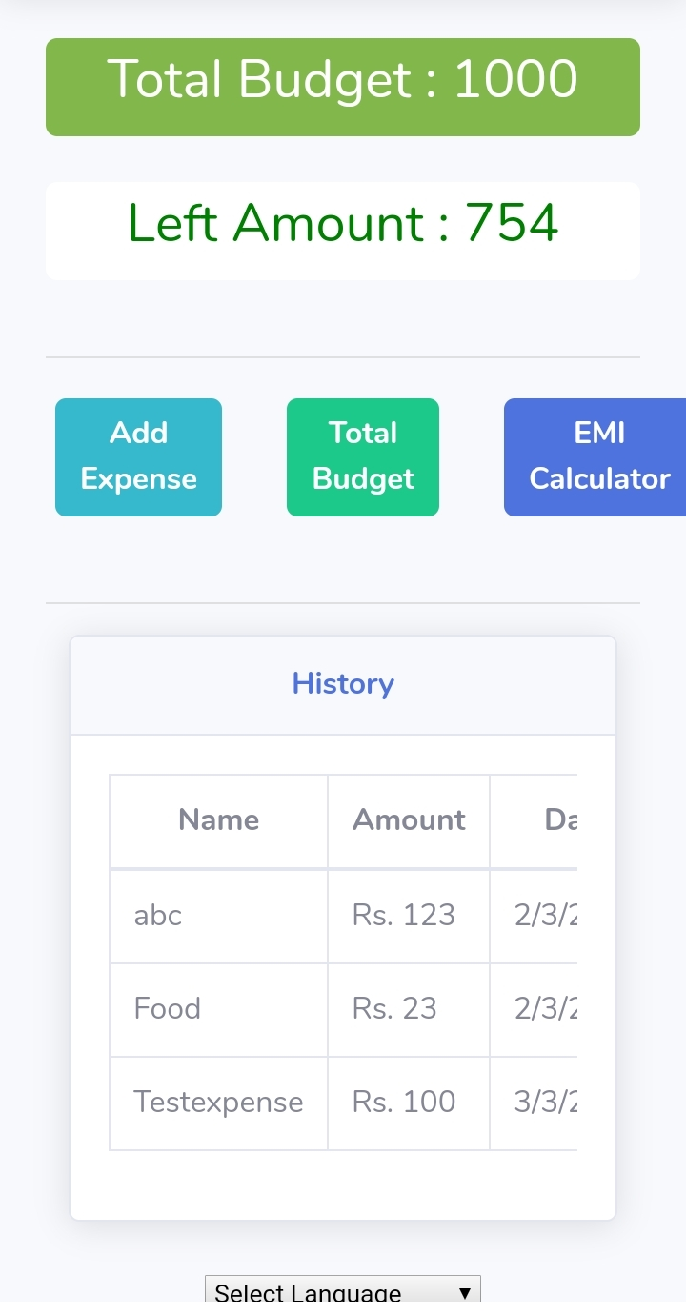

Slide 13

News
Aim : To create awareness among farmers
Solution : A section in the app dedicated to improve awareness in farmers by displaying the news related to farmers and agriculture.

Slide 14
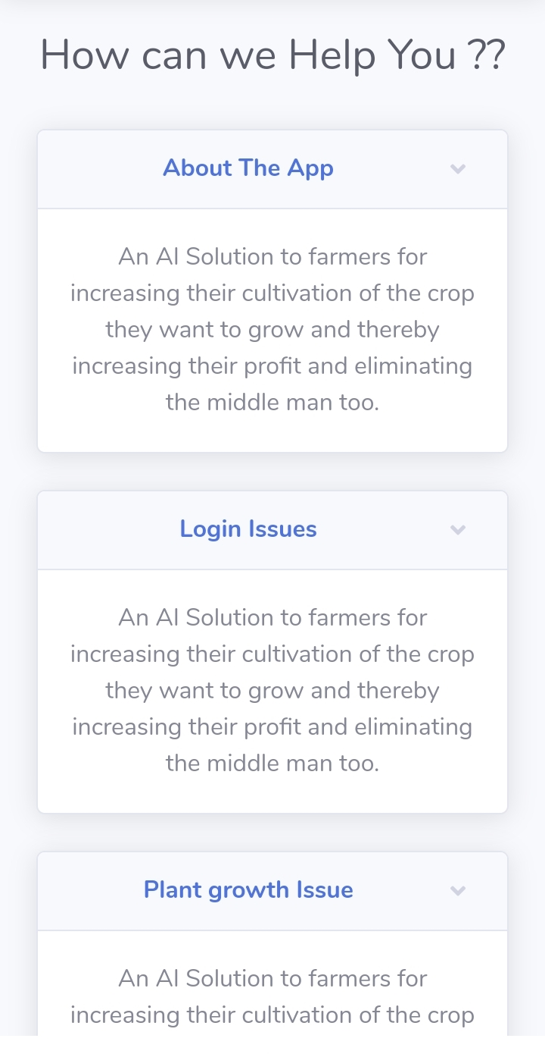
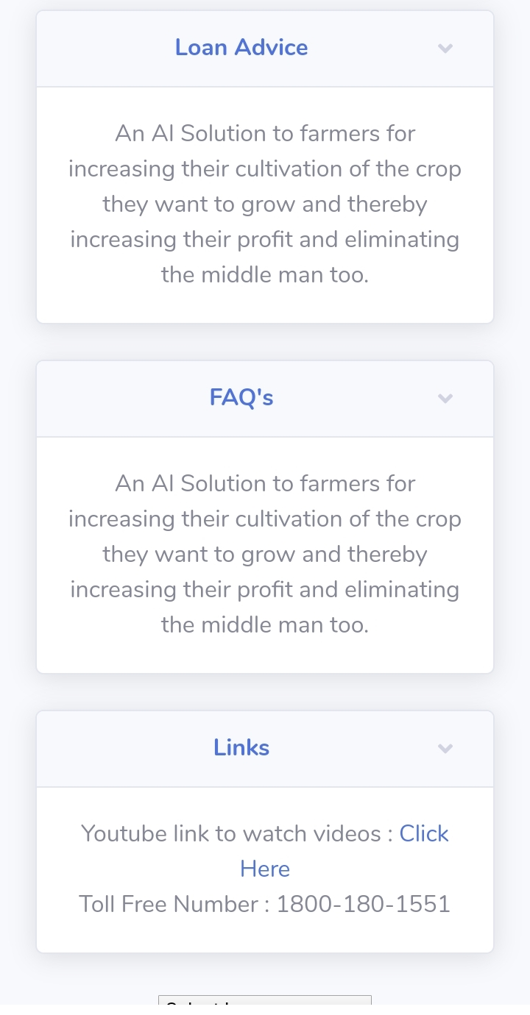
Help

